Slide 1
Gregory Klonis
Solution Architect, Cloud & Infra @Olympia Group
Microsoft Certified Trainer
Community involved, member of Autoexec.gr
Twitter: @gklonis
Linkedin: Gregory Klonis
Blog: greg.Klonis.gr

Slide 2
What is Microsoft Azure?
Microsoft Azure is Microsoft's cloud offering that is made up of redundant data centers throughout the world. Those data centers are located throughout America, Europe and Asia, and the data centers host highly redundant servers that host all of the resources for Microsoft Azure. That includes the resources for Office 365. Microsoft Azure provides software as a service, platform as a service, or infrastructure as a service. And actually many other X as a service solutions for both small and large enterprises.

Slide 3
What is Azure Active Directory?
Azure Active Directory (Azure AD) is Microsoft’s cloud-based identity and access management service, which helps your employees sign in and access resources in:
External resources, such as Microsoft Office 365, the Azure portal, and thousands of other SaaS applications.
Internal resources, such as apps on your corporate network and intranet, along with any cloud apps developed by your own organization.

Slide 4
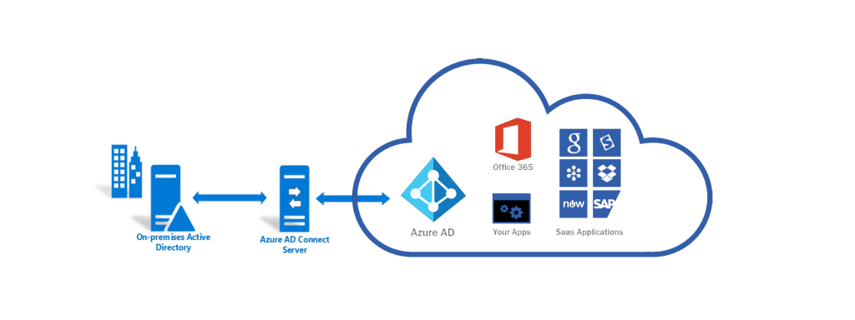
What is Azure AD Connect?
Azure AD Connect is a synchronization tool that connects your local on-premise Active Directory with the Azure Active Directory. Integrating your local domain with the Azure Active Directory will allow your users to access Azure and Office 365 resources with a unified identity, i.e. a single username and password.

Slide 5
AD Connect Features
Filtering
Used to limit which objects synchronized to Azure AD
Password Synchronization
Synchronizes the password hash between Active Directory and Azure AD
Password Writeback
Allows users to change passwords in the cloud while applying on-premises password policies
Device Writeback
Allows devices registered in Azure AD to be written back to on-premises AD for conditional access
Prevent Accidental Deletes
Protects cloud directory from numerous deletes at the same time
Automatic Upgrades
Ensures Azure AD Connect is always updated with the latest release
Notes:
https://docs.microsoft.com/en-us/azure/active-directory/connect/active-directory-aadconnect

Slide 6
What is MFA? (Multi-Factor Authentication)
Azure Multi-Factor Authentication (MFA) helps safeguard access to data and applications while maintaining simplicity for users. It provides additional security by requiring a second form of authentication and delivers strong authentication via a range of easy to use authentication methods.

Slide 7
Active Directory Domain Services VS Azure Active Directory

Slide 8
Active Directory (On-Premises)
There are many other roles that follows Active Directory Domain Services.
Active Directory Rights Management Services (AD RMS)
Active Directory Federation Services (AD FS)
Active Directory Certificate Services (AD CS)
Role-based access control (RBAC)
Group policies, trusts and organization units

Slide 9
Azure Active Directory
Querying
LDAP vs Microsoft Graph REST API
None of the enterprise features
Flat directory structure
NO Group policies, trusts and organization units
It’s a Service, NOT server
NO domain controllers
NO troubleshooting
NO backup needed

Slide 10
Azure Active Directory Management Tools
Microsoft Azure Portal
Portal.azure.com
Microsoft Azure Portal App
We can download and install the application on a PC.
Azure CLI / PowerShell
Through Azure portal we can click on the Cloud CLI icon.
Same functionality as local Windows PowerShell on a PC.

Slide 11
Azure Active Directory P1 vs P2 Licenses
Azure AD Premium P1 - is an enterprise level edition which provides identity management for on-premise users, remote users and hybrid users accessing applications both locally and over the cloud. This edition includes support for self-service identity, access management, administration of dynamic groups including self-service group management, as well as Microsoft Identity Manager which is a suite of on-premise identity and access management tools.
Azure AD Premium P2 - is an edition includes all of the features of Azure AD Premium P1 with the addition of Identity Protection and Privileged Identity Management (PIM). Identity Protection provided management of conditional access to apps and critical data. PIM enhances management of privileged accounts tied to administrative access to resources

Slide 12
Gregory Klonis
Ευχαριστούμε πολύ! ☺

